Slide 1
Design Concepts and Principles

Slide 2
Why design?
The design of the system is one of the most crucial stages:
  “Low” enough to address implementation issues.
  “High” enough to avoid wasting time.
Problems solved at design time will save coding and debugging time; problems left open will become bugs.

Slide 3
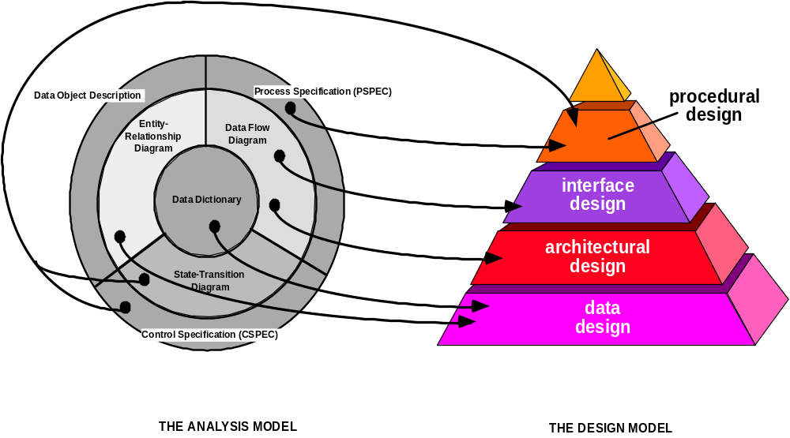
Analysis to Design

Slide 4
Design: Where Do We Begin?
modeling
prototype
spec
design

Slide 5
Design Guidelines
A design should exhibit a hierarchical organization that makes intelligent use of control among elements of software.
A design should be modular – the software should be logically partitioned into elements that perform specific functions and sub-functions.
A design should contain both data and procedural abstractions.

Slide 6
Design Guidelines
A design should lead to modules that exhibit independent functional characteristics.
A design should lead to interfaces that reduce the complexity of connections between modules and with the external environment.

Slide 7
Design Principles
The design process should not suffer from “tunnel vision”.
The design should be traceable to the analysis model.
The design should not reinvent the wheel.
The design should “minimize the intellectual distance” between the software and the problem as it exists in the real world.
The design should exhibit uniformity and integration.
Notes:
Tunnel vision is extremely narrow point of view,it shud have a broader point of view and a central point of view.

Slide 8
Design Principles
The design should be structured to accommodate change.
The design should be structured to degrade gently, even when aberrant data, events, or operating conditions are encountered.
Design is not coding, coding is not design.
The design should be assessed for quality as it is being created, not after the fact.
The design should be reviewed to minimize conceptual (semantic) errors.

Slide 9
Key design concepts
What are we trying to achieve?
  Decomposition
  Abstraction
  Information hiding
  (Correct) Modularity
  Extensibility
  “Virtual machines”
  Hierarchy
Notes:
Abstraction : The process of picking out (abstracting) common features of objects and procedures.
Encapsulation : In programming, the process of combining elements to create a new entity. For example, a procedure is a type of encapsulation because it combines a series of computer instructions.
Information Hiding :In programming, the process of hiding details of an object or function. Information hiding is a powerful programming technique because it reduces complexity.
All three techniques are used to reduce complexity.
Modularity is designing a system that is divided into a set of functional units (named modules) that can be composed into a larger application.
Extensibility - New capabilities can be added to the software without major changes to the underlying architecture.
Virtual Machine : A virtual machine (VM) is an environment, usually a program or operating system, which does not physically exist but is
created ... JVM
Hierarchy : interdepencies with meta data

Slide 10
Decomposition
Large pieces of code are impossible to understand or maintain.
  “Monster” classes
  “Monster” methods
How to avoid?
  Decompose the system to modules until each module has a single major role.
  Distribute responsibility among modules equally
    No “show runners”.

Slide 11
Decomposition rules
The palm rule: a method containing logics should not be larger then your palm.
  Usually a single editor screen
The scroll rule: the entire class should be small enough to scroll through effortlessly.
  Usually less then 1000 code lines, best less then 200.

Slide 12
Decomposition - example
Consider the Simple Mail Transfer Protocol (SMTP) for sending and receiving e-mail.
  Has a sending and receiving side.
  The protocol has several stages (handshake, recipients list, the content itself…)
  All communication is low-level (plain text) and has to be parsed
  Each stage must be handled and acknowledged.
  And so on…

Slide 13

SMTP – phase 1
SMTP
+send()
+receive()
HELP!!!
Isn’t that the class that ate Cincinnati…

Slide 14


SMTP – phase 2
SMTP
Sender
+send()
Receiver
+receive()
Monsters, but small ones…

Slide 15

SMTP – phase 3
Sender
SMTP
Receiver
*
*
SendStage*
RcvStage*
SndRcpts
SndText
SndEnd
RcvPcpts
RcvText
RcvEnd

Slide 16
Abstraction
We want to focus less implementation details and more on functionality and characteristic.
  Implementation can change
  Functionality derives from need
Bad abstraction:
  Exposing fields
  Using drawing commands (point, line, fill…)
Good abstraction:
  Getters/setters
  Shapes (rectangle, circle…)

Slide 17
Information hiding
We strive to hide as much details as possible, to avoid high coupling between modules.
Bad hiding:
  Access to unneeded methods/fields
Better hiding
  Using well-defined interfaces to match the needs.
Best hiding
  Module is operated using a defined set of command (table logic, mini-language)
Notes:
Object oriented techniques will explains the concepts of the beauty of writing the code and shortcuts to reduce the lines of code.

Slide 18
Coupling
Coupling is a measure of the interdependence between two modules.
Keep the modules as independent of each other as possible
Notes:
Coupling: An indication of the strength of interconnections between program units.
Cohesion : A component should implement a single logical function or single logical entity. All the parts should contribute to the implementation.
Cohesion is Intra – Module Concept.
Coupling is Inter -Module Concept.

Slide 19
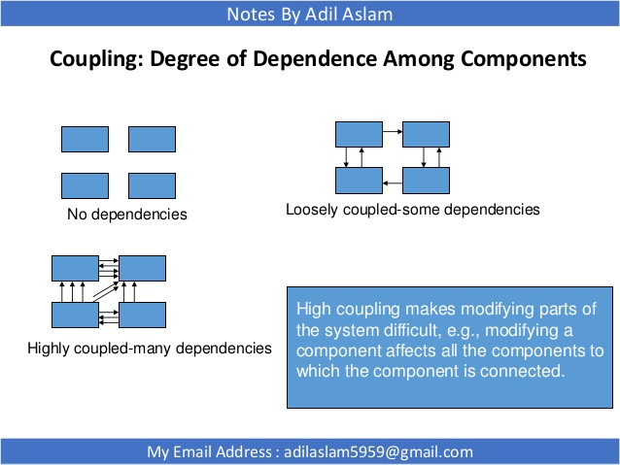

Slide 20
Cohesion
-Cohesion is the measure of the strength of functional relatedness of elements within a module.
-Make each module as cohesive as possible

Slide 21
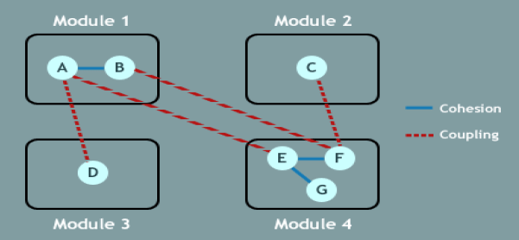

Slide 22
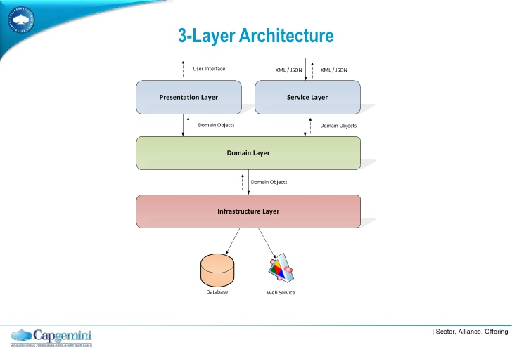

Slide 23
Layering
Software development is totally a layered technology.
The layers of software development
    Quality Focus
    Process
    Methods
    Tools

Slide 24
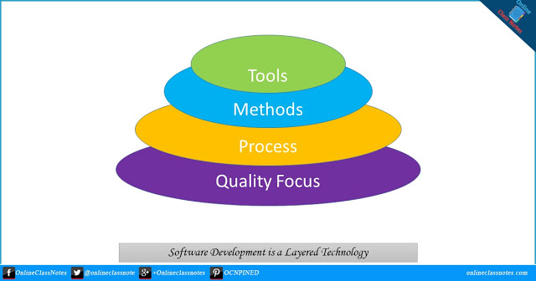
The Upward Flowchart
Notes:
01. A Quality Focus
Software engineering must rest on an organizational commitment to quality. Total quality management and similar philosophies foster a continuous process improvement culture, and this culture ultimately leads to the development of increasingly more mature approaches to software engineering. The bedrock that supports software engineering is a quality focus.
02. Process
The foundation for software engineering is the process layer. Process defines a framework for a set of Key Process Areas (KPAs) that must be established for effective delivery of software engineering technology. This establishes the context in which technical methods are applied, work products such as models, documents, data, reports, forms, etc. are produced, milestones are established, quality is ensured, and change is properly managed.
03. Methods
Software engineering methods provide the technical how-to's for building software. Methods will include requirements analysis, design, program construction, testing, and support. This relies on a set of basic principles that govern each area of the technology and include modeling activities and other descriptive techniques.
04. Tools
Software engineering tools provide automated or semi-automated support for the process and the methods. When tools are integrated so that information created by one tool can be used by another, a system for the support of software development, called computer-aided software engineering, is established.
https://www.onlineclassnotes.com/2013/01/describe-that-software-development-is.html

Slide 25
Layering
Layering represents an ordered grouping of functionality.
-Application Specific – Top Layers
-Functionality/Business Specific – Middle Layers
-System Software – Lower Layers

Slide 26
Factoring
factor the modules intelligently
aim at a high fan-in factor
aim at a low fan-out factor
keep the system balanced

Slide 27
Modularity (1)
High cohesion: when a change occurs, it is quickly reflected to relevant modules.
  Bad cohesion: modules are packaged in an unrelated manner, so change is reflected slowly.
    For example: “all utilities in the system”
  Good cohesion: related modules are close, so it is easy to change them
    Best: all modules responsible for carrying out a common functionality.

Slide 28
Modularity (2)
Low coupling: when a change occurs, it shouldn’t be reflected in unrelated modules.
Usually a result of exposing impl. details.
  For example: exposing the internal structure of a data structure (list, tree…) to allow iteration.
Can be avoided by using an interface or an abstraction
  For example: providing an itertor to allow iteration.
  Even better: a foreach function (Perl, STL, C#)

Slide 29
Extensibility
You will need to modify your system sometime
  New version, requirements change, bug fixes…
The best way to do it is by extending its abilities.
  But for that the right module needs to be extensible
Extension can be done by:
  Inheritance
  Adding elements / plug-ins
  Mini-lang scripting, table logic…

Slide 30
“Virtual Machines”
Allow reusability of systems by supplying a defined set of basic, simple operations.
  The same basic layer can serve several applications.
  Several systems can implement the operations set.
Some more examples:
  OpenGL / DirectX
  CORBA
  SQL / ODBC/ JDBC
  PostScript

Slide 31
Qualities Of Design
Clarity
  easy to understand
  easy to find information
Extensibility
  easy to add new features to the design without re-organization
Maintainability
  easy to make corrective modifications

Slide 32
Qualities Of Design
Implementability
  straight forward to implement without re-organization
Reliability
  leads to reliable implementation
Efficient
  leads to efficient implementation

Slide 33
Methodology
When
(i) a Sufficient body of guidelines have been established, documented, and lead to specific design artifacts that communicate the design
(ii) there is a broad consensus of how to apply the rules and develop the products
then the approach is called a method or a methodology

Slide 34
Design Methods
Design methods can be broadly classified into
Data-Oriented
Function-Oriented
Object-Oriented
Formal Methods
Component-Oriented

Slide 35
Data Oriented Design
Also known as information engineering.
Analysis is performed on a system’s data entities.
Data Requirements are extracted.
Data Requirements drive the program design.

Slide 36
Data Oriented Design
Entities are determined for each subsystem.
Entity inter-relationships are examined to develop the additional entities needed to support the relationships.
The process iterates until the entity relationships can no longer be expanded.

Slide 37
.. Data-Oriented Design
The callable components are structured in accordance with the structure of the data.
The architecture of the system is derived from the earlier specified architecture of data, i.e., the entities and their relationships.
Can be modeled by an Entity-Relationship Diagram – ERD.

Slide 38
.. Data-Oriented Design
Data must be defined in detail first.
An implication of the above fact is that, when the data structure changes, the structure of the program units must also change.

Slide 39
.. Data Oriented Design
is useful for systems that process lots of data
that will be programmed using a procedural language such as COBOL.
e.g. database and banking applications

Slide 40
Function-Oriented Design
Also known as Structured Design.
Process Decomposition is done.
Process Requirements are extracted.
Process Requirements drive the program design.

Slide 41
.. Function-Oriented Design
Fundamental principle is to partition the program into a set of steps (sub programs) that can be considered as black boxes, hiding the details of their processing.
Sub programs represent the functions to be accomplished to satisfy the requirements of the user.
This is called functional decomposition.

Slide 42
.. Function-Oriented Design
Partitioning is hierarchical and ordered.
The top level of the program should provide the complete solution calling sub-ordinate sub programs when necessary.
Sub programs in-turn call their sub ordinate sub programs and so on.
This repeats until the requirements of the program are satisfied by small size sub programs.

Slide 43
.. Function-Oriented Design
Decomposition has a focus on algorithmic considerations.
The Design of data parameters is addressed after the process modules are fully decomposed.
Avoidance of common data – Parameter passing mechanism.
Emphasis on Cohesion and Coupling.

Slide 44
.. Function-Oriented Design
The Specific design of the data is often widely visible.
Implication of the above fact is that, if the data structure is changed, much of the logic of the programming potentially at many places in the program must change as well.
Can be modeled using Structure charts, Data flow diagrams, flow charts etc.

Slide 45
Function Oriented Design
is useful for process intensive systems
those that will be programmed using a procedural language such as
FORTRAN.

Slide 46
Object Oriented Design
Hybrid of data-oriented and function-oriented design.
Break the system into objects.
Objects are cohesive units of related attributes and methods.

Slide 47
.. Object-Oriented Design
Emphasis on Data Abstraction.
Keywords: Class, Object, Inheritance etc.
Binding the related data and methods together.
Can be modeled using Class diagrams.

Slide 48
.. Object Oriented Design
useful for any system that will be programmed using an object oriented language such as C++.
particularly well suited to developing large software systems.

Slide 49
Formal Methods
Use a formal language to describe a software artifact such as a specification, design, source code.
The language enables the application of formal proofs to assess the correctness of an artifact.
Formal:
in a language with mathematically defined syntax and semantics.

Slide 50
.. Formal Methods
Main Activities:
Writing formal specifications.
Proving properties about formal specifications.
Constructing a program by mathematically manipulating a formal specification.
Verifying a program by mathematical argument.
Can be modeled using pseudo-code

Slide 51
.. Formal Methods
considered to be an alternative to OO and classical design methods
their use is expensive and claims of reduced errors remain unproven
the ability to formally validate the correctness of a software artifact is appealing and research on formal methods is ongoing
Formal methods were utilized to develop the most critical sections on an air-traffic control project for Britain's Civil Aviation Authority

Slide 52
.. Component-Oriented Design
Emphasis is on Software-Reusability
Main attention points are:
Design and discovery of components
Ensuring that components satisfy the software requirements
Managing components
Mapping rules from COD to Component Programming (java, COM, C#)
Validation using several test cases

Slide 53
..Component-Oriented Design
De-facto paradigm for developing large software systems.
enterprise scale distributed applications
N-tier web applications.

Slide 54
Real-Time Systems
Systems that are required to produce intended results at (or around) a specific point on the time scale.
They are measured both on value and the temporal domains.
Not fast but predictable.

Slide 55
.. Real-Time Systems
A Real Time System is one in which the correctness of the system behavior depends not only on the logical result of the system, but also on the physical instant at which these results are produced.
-Kopetz
Notes:
Satellite control systems
Air Traffic control systems

Slide 56
Real-Time Systems- Definition
A real time system is a system that
must satisfy explicitly (bounded)
response time constraints or risk
severe consequences, including failure,
loss of life and property

Slide 57

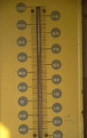
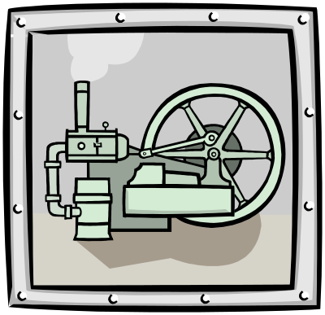




Concurrent Processing
Correlated processing of two or more
inputs over the same time interval
Notes:
Parallel concurrent processing allows you to distribute concurrent managers across multiple nodes in a cluster.
Concurrency is the execution of multiple tasks at the same time, regardless of the number of processors.
Parallelism is the execution of multiple processors on the same task.
Multiprogramming
Multiprocessing
Multitasking
Distributed Systems

Slide 58
Recap

